Slide 1


INTRODUCTION TO HISTOPATHOLOGY
By
OSIAGWU DANIEL

Slide 2
OBJECTIVES
At the end of this unit, you should be able to:
Define Pathology and histopathology
Have an understanding of the Pathologic bases of diseases
Understand and discourse the various aspects of histopathology.

Slide 3
INTRODUCTION TO PATHOLOGY
Pathology can be defined as the science that deals with the study of diseases and the body's response to diseases.
Pathology is the study (logos) of disease (pathos) by scientific methods.
Pathos (disease)
Logos (study)
Devoted to the study of the structural, biochemical, and functional changes in cells, tissues, and organs that underlie disease
BRANCHES OF PATHOLOGY
Morbid Anatomy(Anatomical or Anatomic,Histo/Cellular pathology)
Immunopathology
Clinical or chemical pathology
Medical Microbiology
Hematology and blood transfusion
Molecular Pathology
Forensic pathology

Slide 4

ASPECTS OF MORBID ANATOMY(HISTOPATHOLOGY)PRACTICE
Surgical Pathology
Cytopathology
Autopsy
Surgical Pathology
Is the study of tissues removed from living patients during surgery to help diagnose a disease and determine a treatment plan.
Cytopathology
Involves examining cells from bodily tissues or fluids to determine a diagnosis. Scientist/Pathologist will look at the cells in the tissue sample under a microscope and look for characteristics or abnormalities in the cells.
Autopsy
An autopsy is a medical procedure performed on the human body after death
It involves the systematic dissection and examination of human tissues exclusively for medical reasons such as discovering the cause circumstances and mechanisms of death.

Slide 5
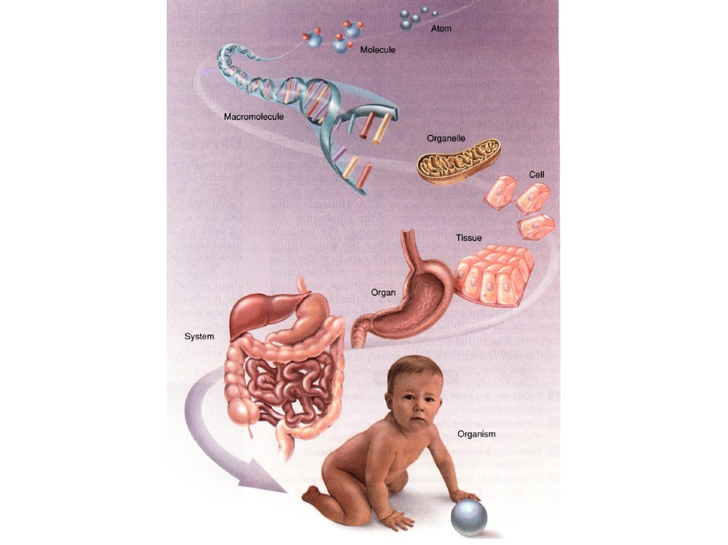
Hierarchy of Anatomical Organization

Slide 6
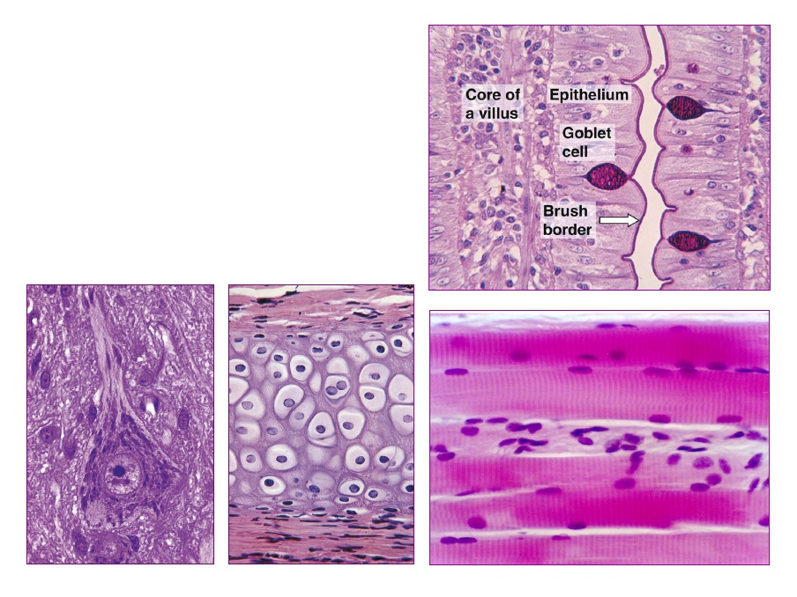
TYPES OF TISSUE
Molecules (simple and macro)
Sub-cellular (organelles)
Cells (cytology)
Tissues (histology)
Organs (organology)
Organ systems
Organism - Societal / Ecological
Epithelial tissue
Connective tissue
Muscular tissue
Nervous tissue

Slide 7
WHAT IS HISTOPATHOLOGY ?
Histopathology is the study of the microscopic anatomical changes in tissues caused by disease.
It is an intellectually satisfying discipline.
It deals with the tissue diagnosis of disease. “This branch of medicine deals with the changes in tissues caused by disease"
Histopathology is devoted to the study of the structural and functional changes that underlies diseases. It is divided into:
General pathology
Systemic pathology

Slide 8
General pathology deals with the basic reaction of cells and tissues to abnormal stimuli that underlie disease.
Systemic Pathology examines specific response of specialized organs and tissue to more or less well defined stimuli.
The four disease processes that form the core of pathology:
Its cause or etiology
Pathogenesis or the mechanism of the development of the disease.

Slide 9
Morphology or the structural alteration induced in the cells and organs of the body.
Clinical syndromes or the functional consequences of the morphological changes.
NOTE
The earlier a disease is detected and treated, the greater the chance of a cure and the more cost-effective the treatment.

Slide 10
CELLULAR PATHOLOGY/HISTOPATHOLOGY
Cellular pathology is the study of disease in cells, tissues and organs.
It is the study and diagnosis of disease through examination of tissues, organs, body fluids and whole bodies (Autopsy).
Used to diagnose illnesses and medical problems
Cellular pathology also known as anatomical (or anatomic) pathology is the branch of pathology that involves the study of body organs and tissues (groups of cells)
Histopathology
Cytopathology

Slide 11
Histopathology is the study of tissues removed from living patients during surgery to help diagnose a disease and determine a treatment plan.
The majority of histopathology examinations are undertaken on tissue obtained from patients undergoing a tissue biopsy for diagnostic purposes.
Histopathology is also used to help the establishment of cause of death as part of a post-mortem examination
All histopathological examination of tissues starts with;-
Surgery
Biopsy
Autopsy

Slide 12
Histopathology
Surgical Pathology
- Biopsies
Incisional biopsy
Excisional biopsy
- Needle biopsy (FNAB)
- Endoscopic biopsy
Cytopathology is closely allied to histopathology but is distinct because the diagnostic information is acquired following analysis of cell preparations.
Cytopathology
The study of cellular changes and everything related to cells, It Involves examining cells from bodily tissues or fluids to determine a diagnosis: –
- Exfoliate cytology
- Fluid cytology
- Washing cell
- Fine needle aspiration cytology (FNAC)
- Urine
- Sputum
- Semen

Slide 13
TYPES OF BIOPSIES
Currettings-
Fragments of tissue harvested by scraping the site of the disease process.
Skin
Endometrium
Bone
Endoscopic biopsy – capsule /pill camera
Tissue harvested using an endoscope—a camera is used to visualize the biopsy site and small pincers are used to harvest and retrieve the tissue.
Endoscopy facilitates the examination of internal organs and the luminal surfaces
Genitourinary tract
Sinonasal tract
Respiratory tract
Gastrointestinal tract

Slide 14
Core biopsy –
A large-bore needle is used to harvest deep tissue samples, producing a long, thin core of tissue
Breast
Prostate
Muscle
Punch biopsy -
An instrument similar to a hole punch is used to take a disc of tissue (size: 2–6 mm diameter).
Skin
Oral cavity
Cone biopsy -
Removal of the cervical squamocolumnar junction.
Cervix
Pipelle biopsy -
Sampling of the endometrium using a small-gauge needle.
Endometrium

Slide 15
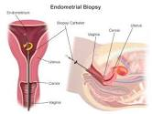
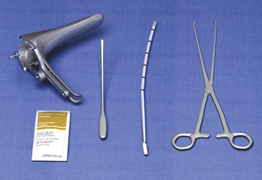
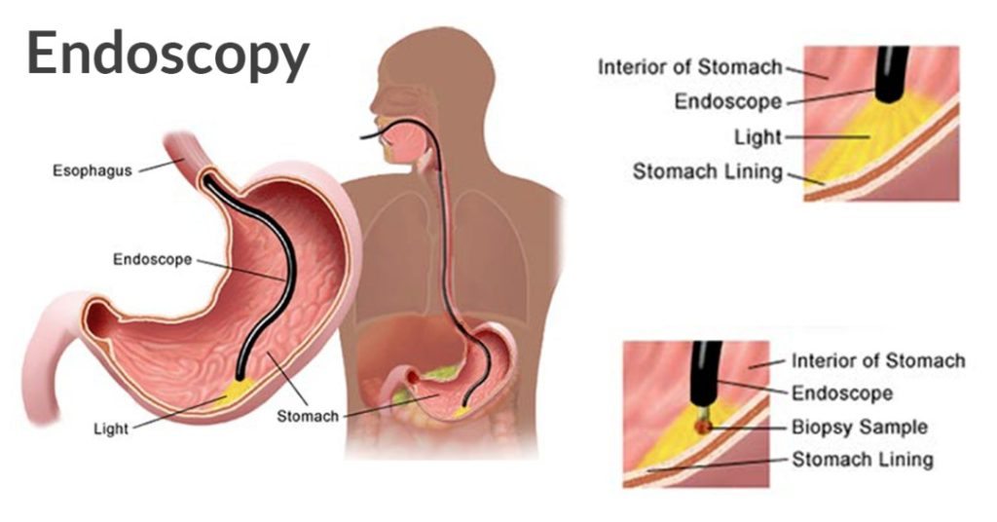
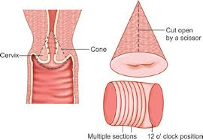

Slide 16
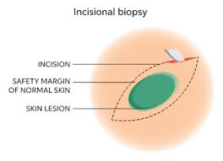
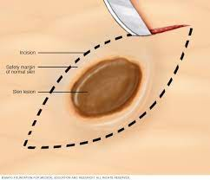
Incision biopsy -
A scalpel is used to incise the lesion and remove a sample.
Skin
Oral cavity
Excision biopsy -
Complete removal of diseased tissue with a small margin of healthy tissue.
Skin
Upper gastrointestinal tract

Slide 17
Resection -
Typically, a complex surgical procedure to achieve complete removal of diseased tissue with a margin of healthy tissue; the surgical site may require reconstruction with tissue from another part of the body.
Gastrointestinal tract
Genitourinary tract
Respiratory tract
Liver
Spleen
Kidney
Amputation -
Removal of an extremity.
Digits
Arm
leg
ear

Slide 18
HANDLING OF BIOPSY AND AUTOPSY SAMPLES
Fixation
Specimen collection
Transportation
Reception
Tissue selection and description
Cutting/slicing/dissection
Processing
Dehydration
Clearing
Infiltration
Impregnation
Embedding
Microtomy
Staining and mounting

Slide 19
Quality assurance
Microscopy
Reporting
Other request: e.g.
SS – Special stains
IHC - Immunohistochemistry
FISH – fluorescent in-situ hybridization
Molecular methods (PCR)
MDT – Multi-disciplinary meetings

Slide 20
REFERENCES AND FURTHER READING
Kumar, V., Abbas, A. K., & Aster, J. C. (2015). Robbins and Cotran pathologic basis of disease (Ninth edition.). Philadelphia, PA: Elsevier/Saunders.
Emmanuel Rubin, Howard M.R Essentials of Rubin’s Pathology. Sixth edition.
Robbins Pathologic Basis of Disease 7th Edition Histology for Pathologists by Mills, SE, 3rd Ed.
Robbins and Cotrans, Pathologic Basis of Disease 9th Edition
D. J Cook: Cellular pathology – 2nd Edition
Steven G. Silverberg : Principles and practice of surgical pathology and cytopathology. 3rd Edition

Slide 21
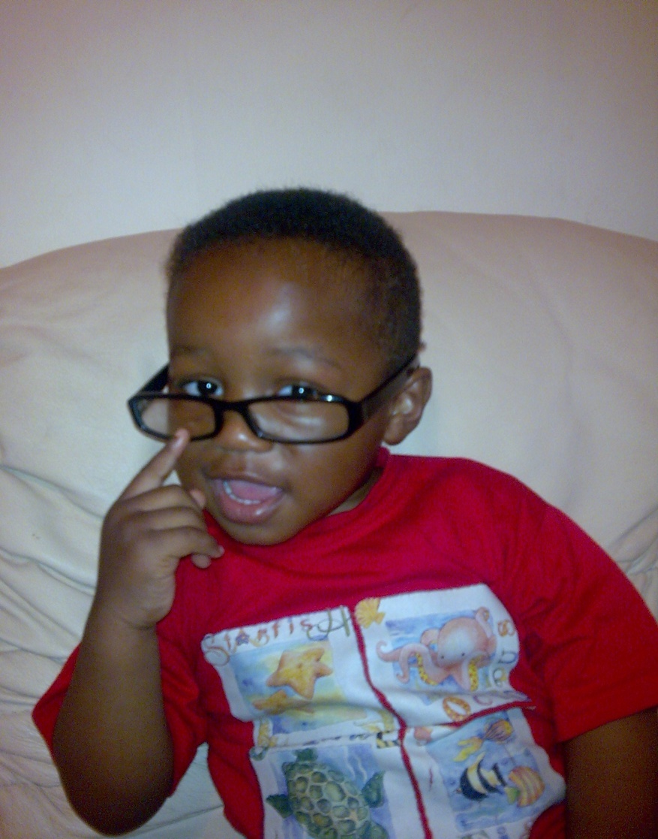
Do not worry, because worries will not remove the sorrows of tomorrow, but will drain you of the strength of today
-- Stephen Furtick.
THANK YOU

